Slide 1
Database Systems Spring-2025 Department of Computer Science The Islamia University Bahawalpur
Submitted by:
Name: Mian Muhammad Irtaza
Roll number: F24BDOCS1M01267
Section: 8M Submitted to:
Muhammad Usman Ghani

Slide 2
Punjab Power Infrastructure 2024

Slide 3
Introduction

Slide 4
Background
Pakistan's Punjab province, home to over 110 million people, faces significant challenges in electrical power management including:
Aging power infrastructure.
15-20% transmission losses.
Lack of real-time monitoring between 58 districts
Unbalanced load distribution during peak hours
This relational database system modernizes the province's power management by digitizing the complete generation-transmission-consumption cycle.

Slide 5
Goals
Primary Objectives:
Create a unified digital repository for all power infrastructure assets.
Reduce transmission losses through intelligent load analytics.
Enable real-time monitoring of 25+ power plants and 58 grid stations.
Provide consumption trend analysis for each districts.
Sustainability Metrics(Renewable energy% to Non-renewable energy%)
Support future integration of transmission lines and power plants.

Slide 6
Requirements
Functional
Hardware / Software
Record real-time data from all power plants.
Track district-wise consumption with accuracy.
Map the transmission lines with voltage/capacity metadata.
Identify abnormal consumption.
Notify staff when plant efficiency drops.
Auto-generate reports according to compiled data.
Database Server
Application Server
Networking
Database(PostgreSQL)
real-time data streaming software
Monitoring software
Compatible OS for all devices which shall be used.

Slide 7
Functional Description

Slide 8
Method of Use
Primary Users
Usage Scenarios
Grid Operators – Monitor real-time power generation/transmission and balance loads.
DISCO Engineers – Track distribution losses and manage outages.
NEPRA Regulators – Audit compliance and analyze data.
Provincial Planners – Forecast demand and optimize infrastructure investments.
Power Plant Managers – Report generation metrics and maintenance needs.
Real-Time Monitoring: Grid operators track 500kV/220kV line capacities.
Billing Support: DISCOs correlate consumption with customer meters.
Emergency Response: Outage alerts trigger repair crews via SMS/email.
Long-Term Planning: Planners simulate grid expansions using historical data

Slide 9
Entity Data Model

Slide 10
power_plants
plant_id
name
type
capacity_mw
location
status
plant_production
record_id
city_id
total_consumption_mw
dountime_hours
peak_load_mw
year
power_plant_supply
id
plant_id
station_id
supply_capacity_mw
population
cities_id
provence
cities
city_name
grid_stations
station_id
name
city_id
capacity_mwa
city_consumption
record_id
city_id
total_consumption_mwh
year
Avg_consumption_per_capita
peak_demand_mw
transmission_lines
line_id
from_station_id
to_station_id
voltage_level
length_km
status
max_vapavity_mw

Slide 11
Description
This relational model centralizes Punjab’s power infrastructure management through seven core entities:
cities
power_plants
grid_stations
transmission_lines
plant_production
city_consumption
power_plant_supply
The data model establishes a hierarchical flow from power generation to distribution and end-use. Transmission lines act as edges in this network, with production/consumption tables capturing time-series metrics. The schema enables loss analysis across geographic nodes.

Slide 12
Schema

Slide 13
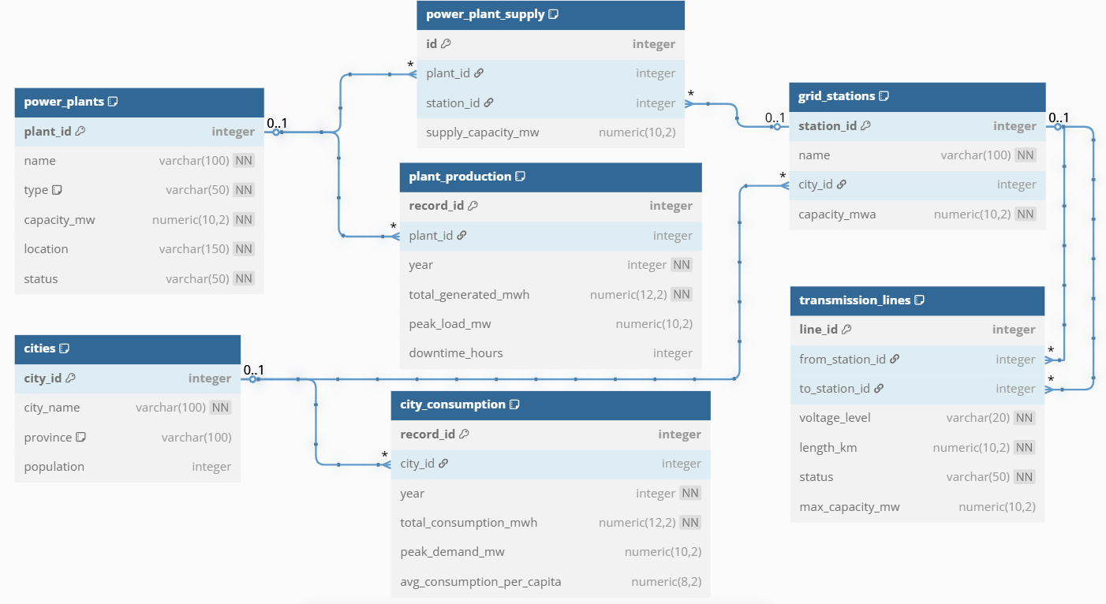

Slide 14


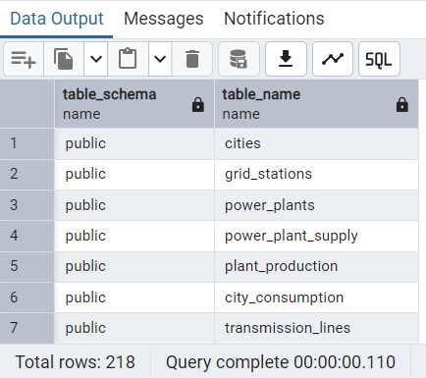
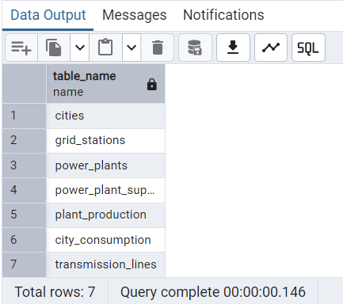
Table names and their Schema structures

Slide 15
Example queries & Outputs

Slide 16
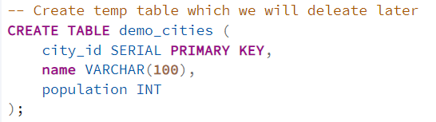
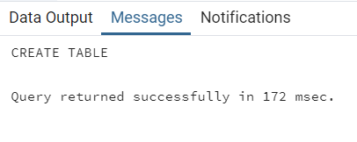
Create temp table which we will delete later

Slide 17
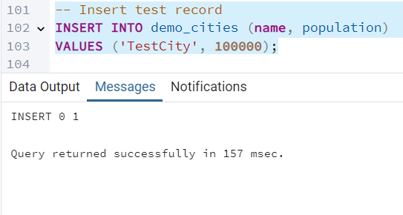
Insert test record

Slide 18
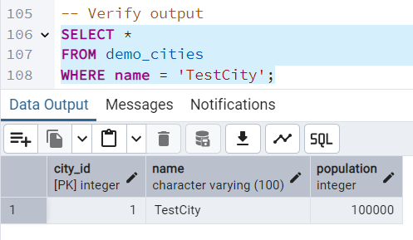
Verify Output

Slide 19
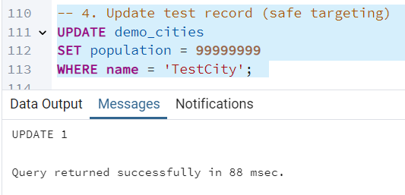
Updating record

Slide 20
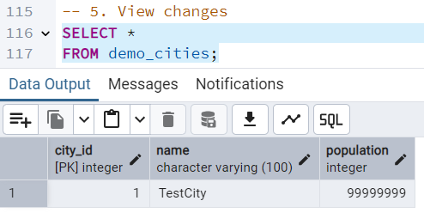
Viewing changes

Slide 21
Extracting Insights from DataBase

Slide 22
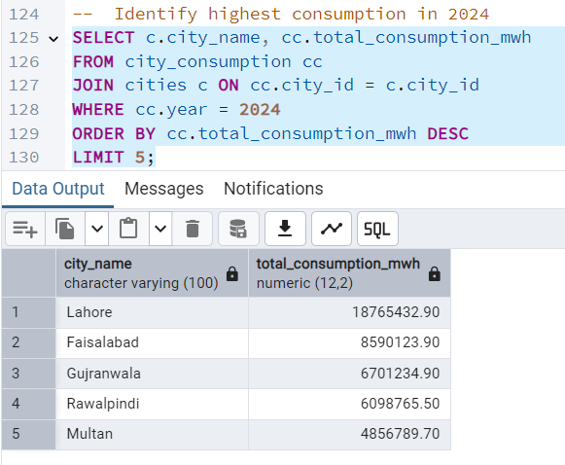
Identify highest consumption in 2024

Slide 23
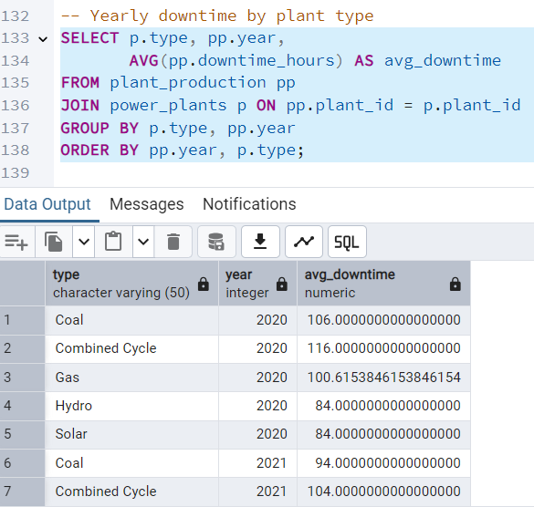
Yearly downtime by plant type

Slide 24
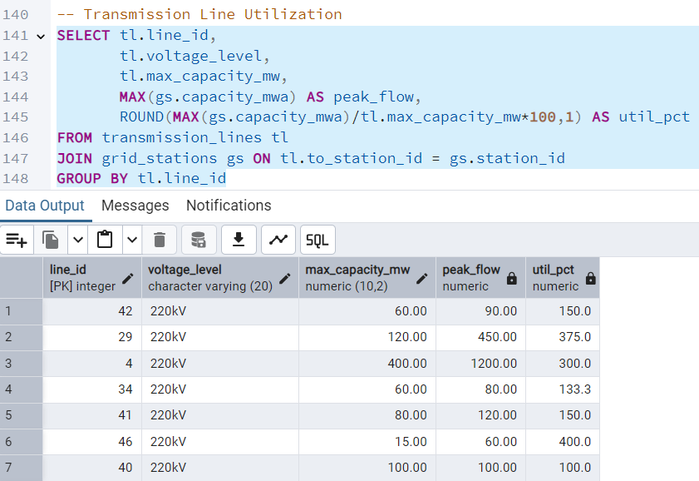
Transmission Line Utilization

